Slide 1
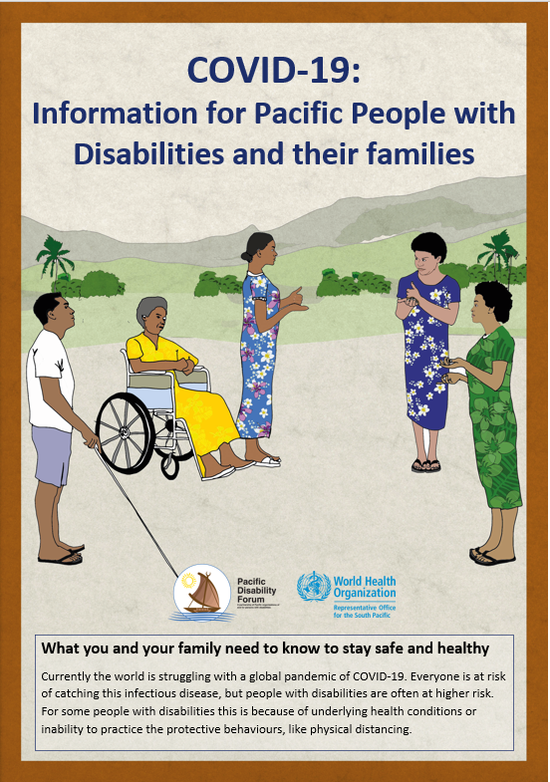
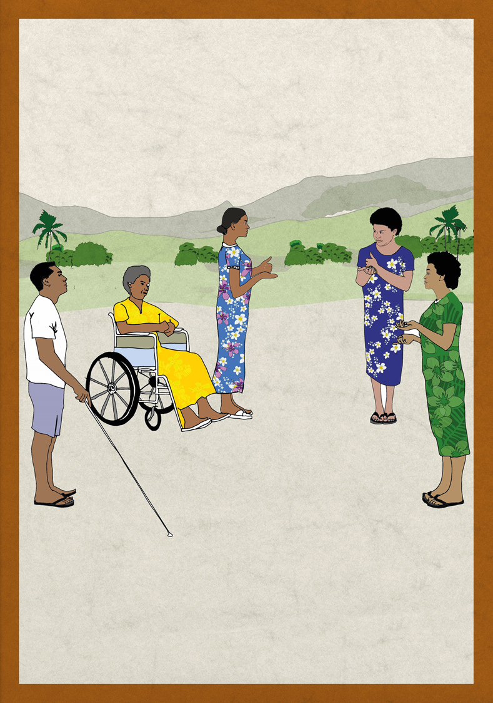
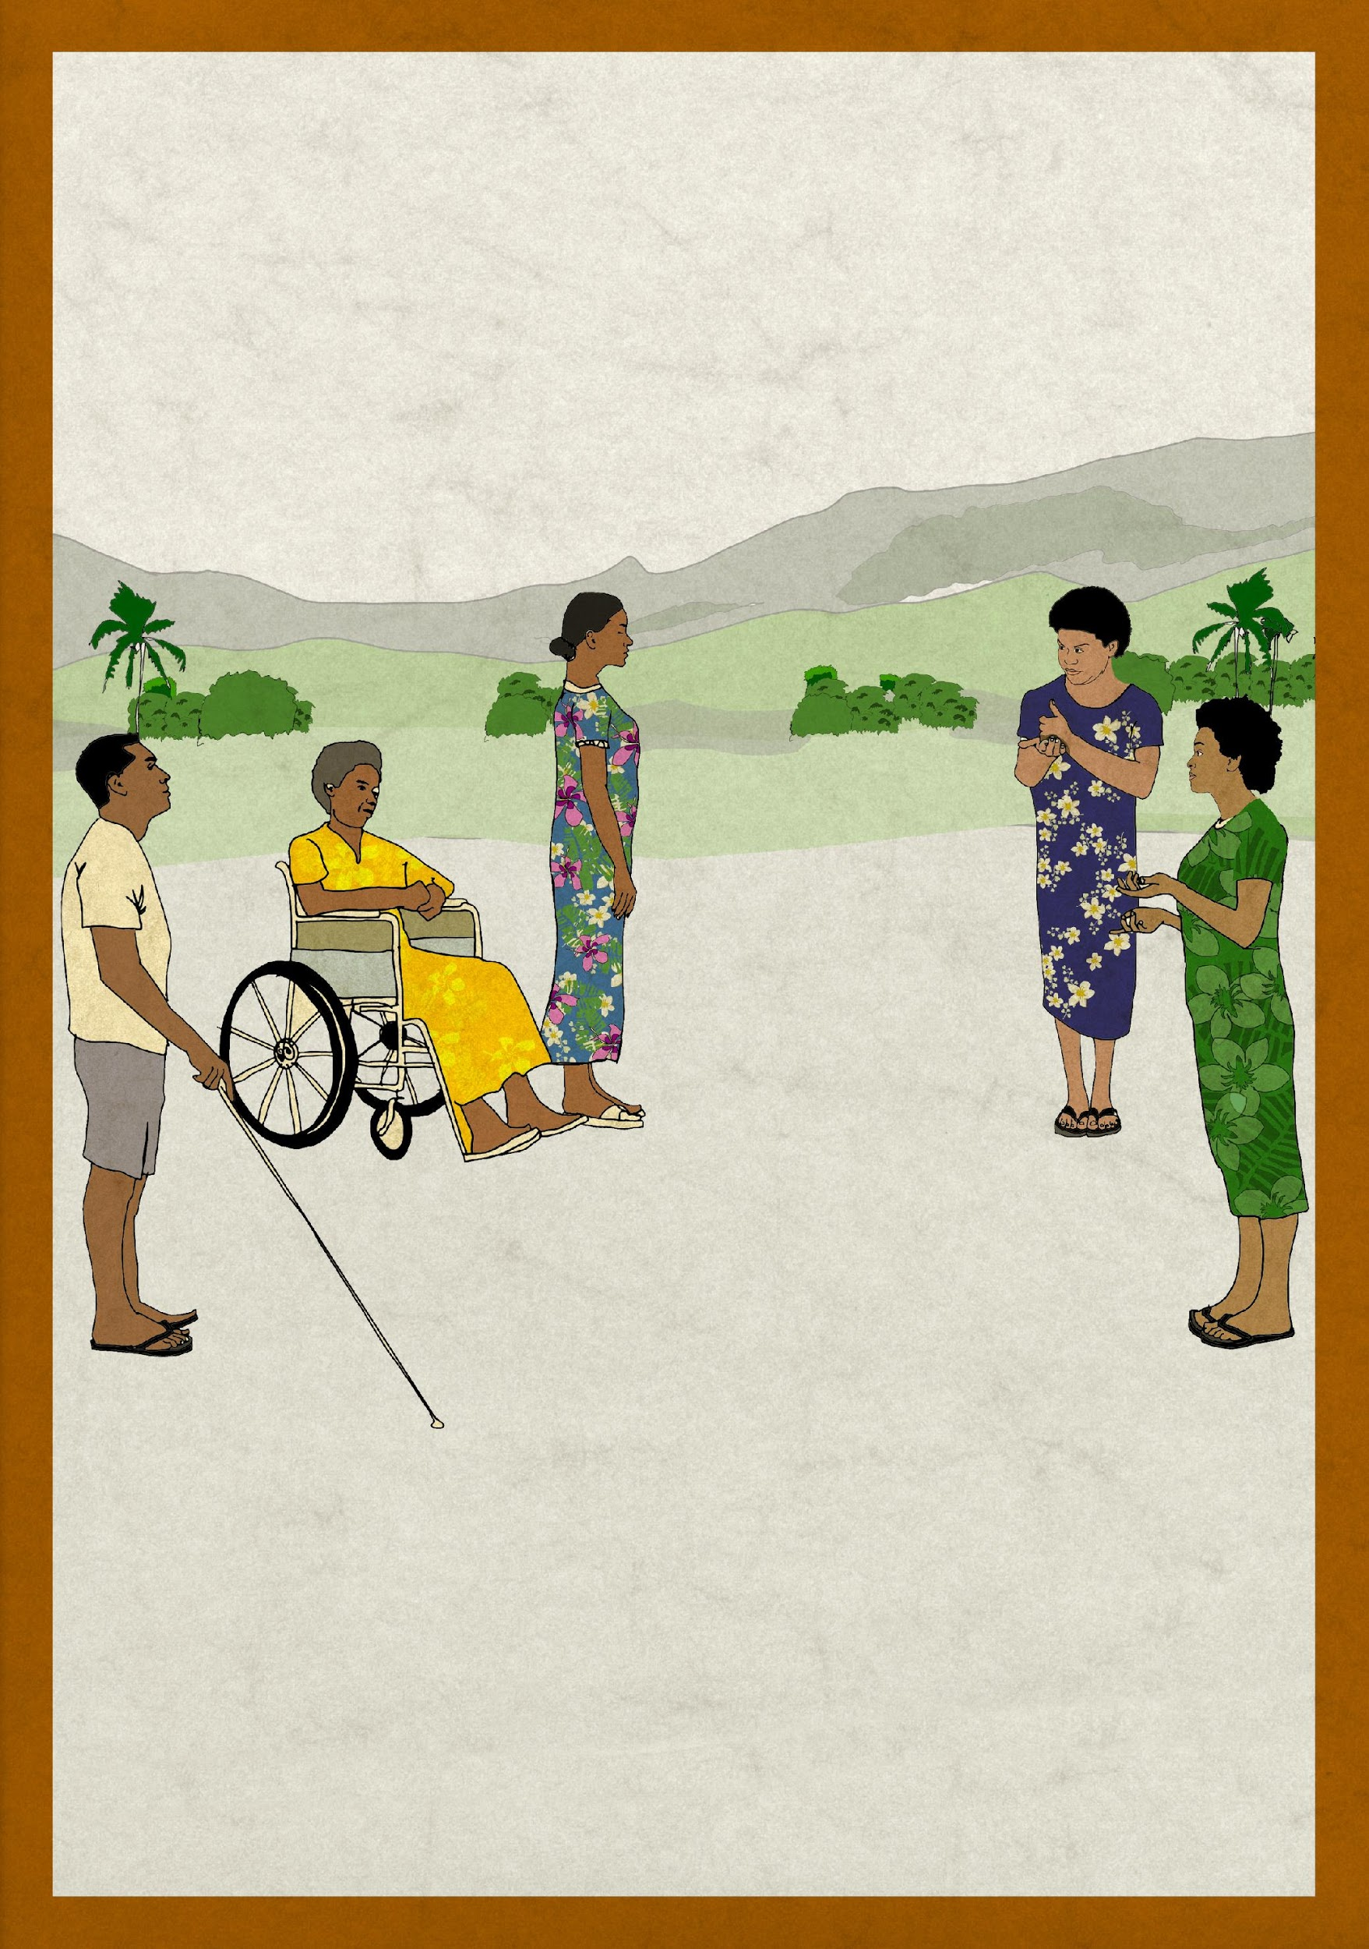
COVID-19:
Information for Pacific People with Disabilities and their families
PACIFIC DISABILITY FORUM
Kadavu House, Suva
What you and your family need to know to stay safe and healthy
Currently the world is struggling with a global pandemic of COVID-19. Everyone is at risk of catching this infectious disease, but people with disabilities are often at higher risk. For some people with disabilities this is because of underlying health conditions or inability to practice the protective behaviours, like physical distancing.

Slide 2
What you can expect for the future?
Until we have a vaccine or treatment, we must stay alert and adapt to a new way of living. In this period, everyone, everywhere must do their part.
This means always practicing the simple steps to preventing COVID-19 and changing our environments to reduce the risk. This includes everyone taking additional personal protective measures, like regular cleaning of hands, frequently wiping down of surfaces that are touched often, coughing and sneezing into our elbows or a tissue, and keeping distance from others, if possible. If there are cases of COVID-19 in our country or community, it is critical that these simple steps are practiced and information from authorities followed.
This information sheet is to provide you some information about how you and family members can plan and prepare for the impacts of COVID-19.
What you can do:
A
B
C
Know the facts
about COVID-19
Protect yourself
Develop your own COVID-19 household action plan with your family, friends and service provider

Slide 3
A
Know the Facts
It is important that all household members, including people with disabilities, know the facts about COVID-19. This will help to make informed decisions about how to protect yourself and your family.
What is COVID-19?
COVID-19 is an infectious disease that spreads easily from person to person. Currently the world is struggling with a global pandemic due to this infectious disease.
How serious is COVID-19?
Most people experience mild, flu-like symptoms, but for some people it can cause very serious illness and can be fatal.
People who are most at risk of experiencing serious illness are elderly people (over 60 years) and people with existing medical conditions, like heart disease, diabetes and hypertension.

Slide 4
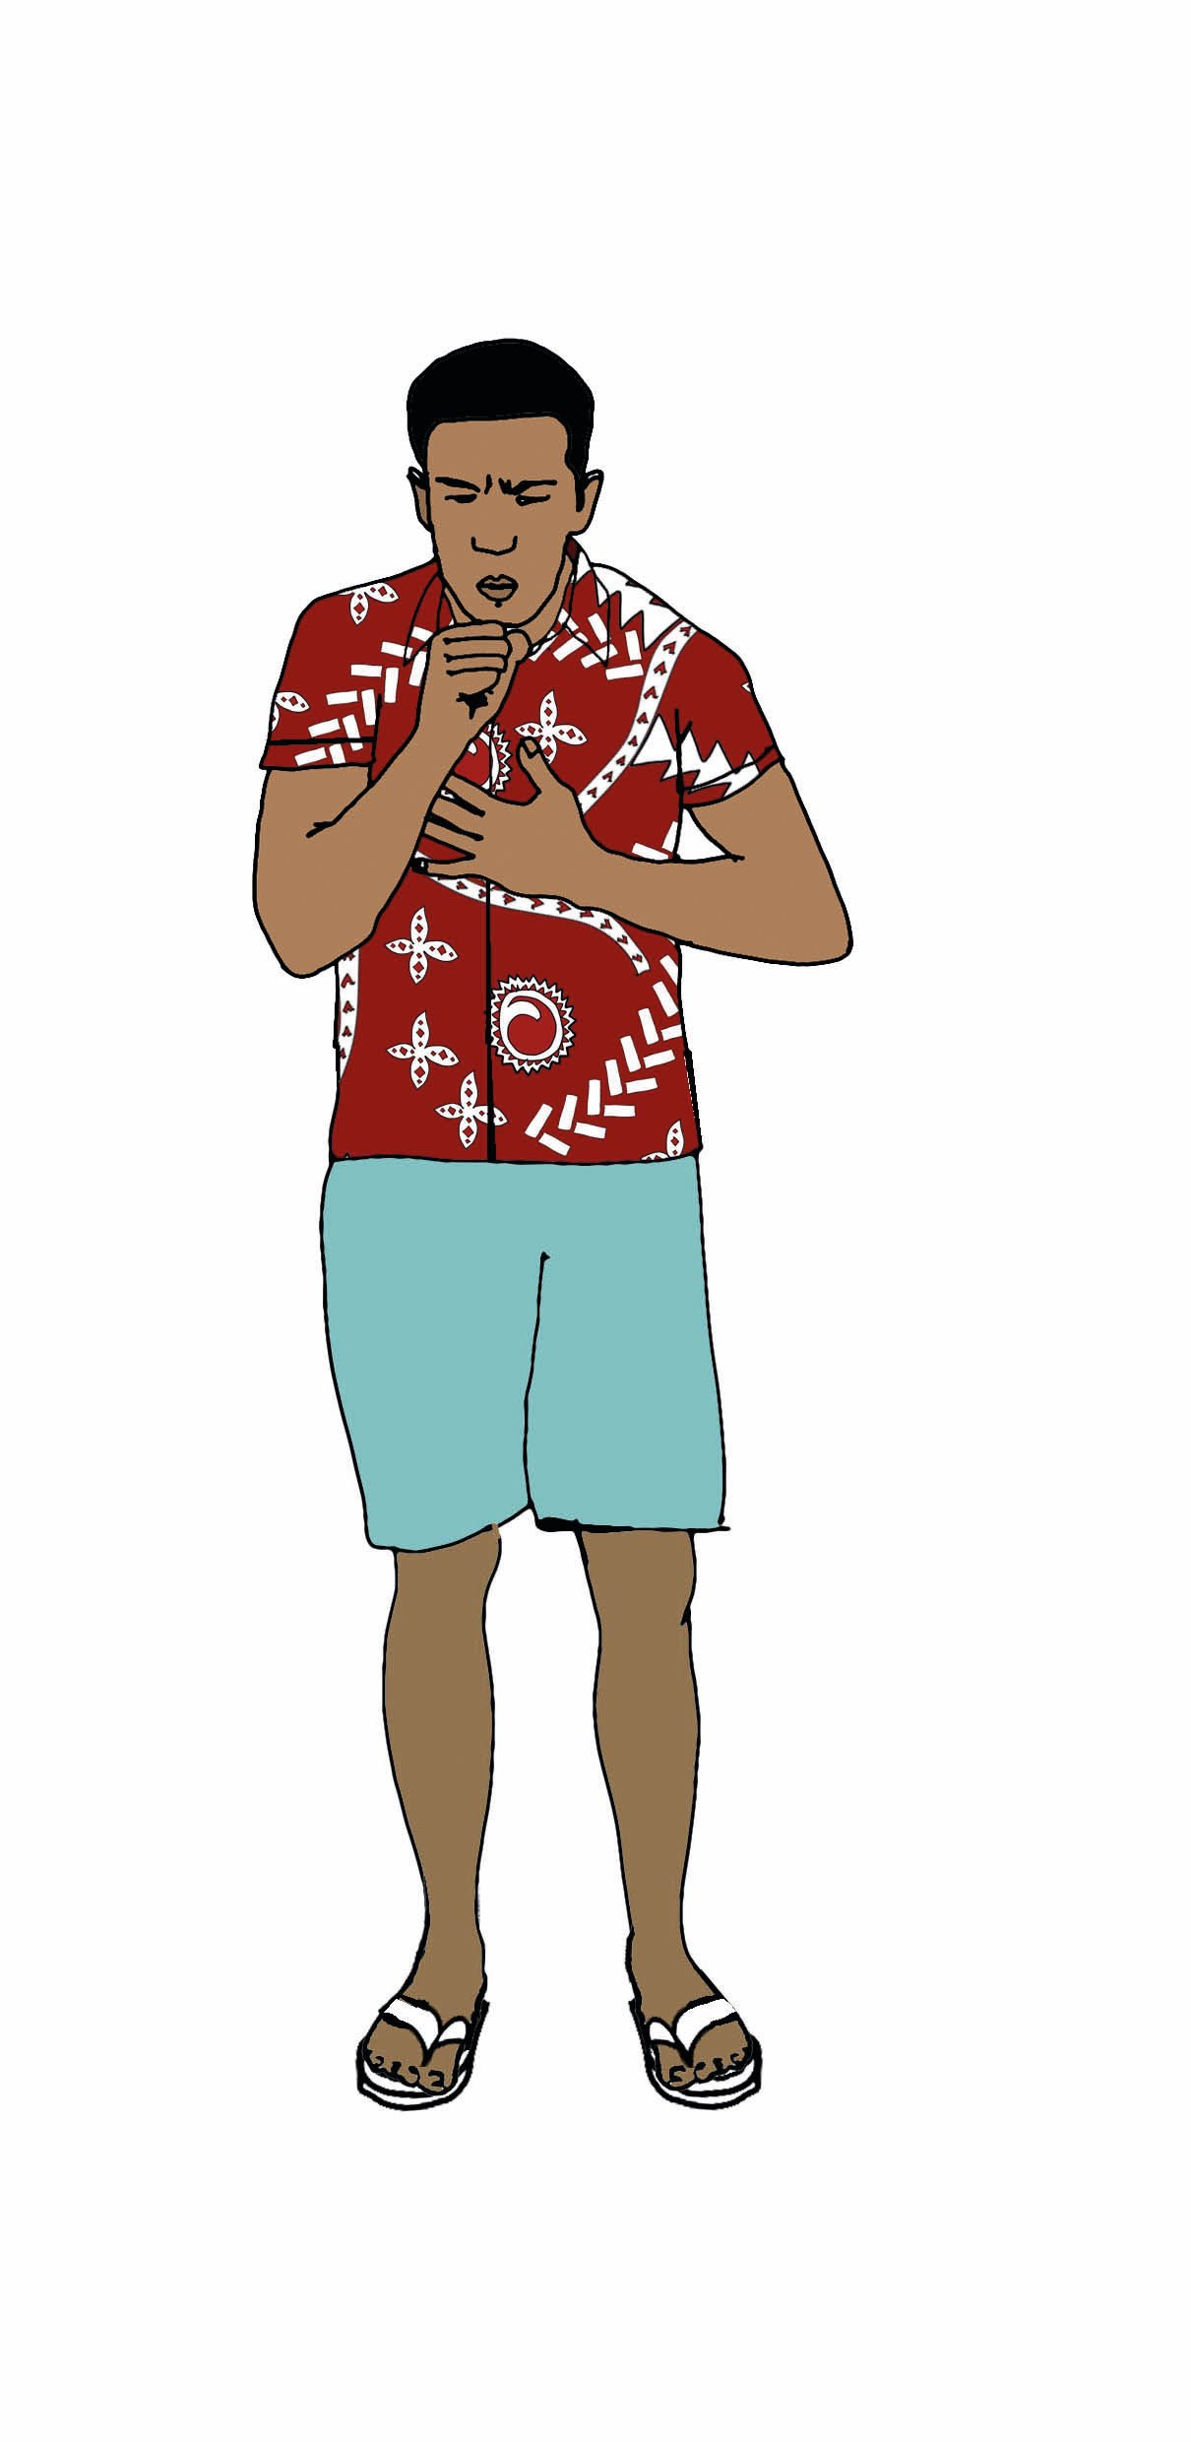
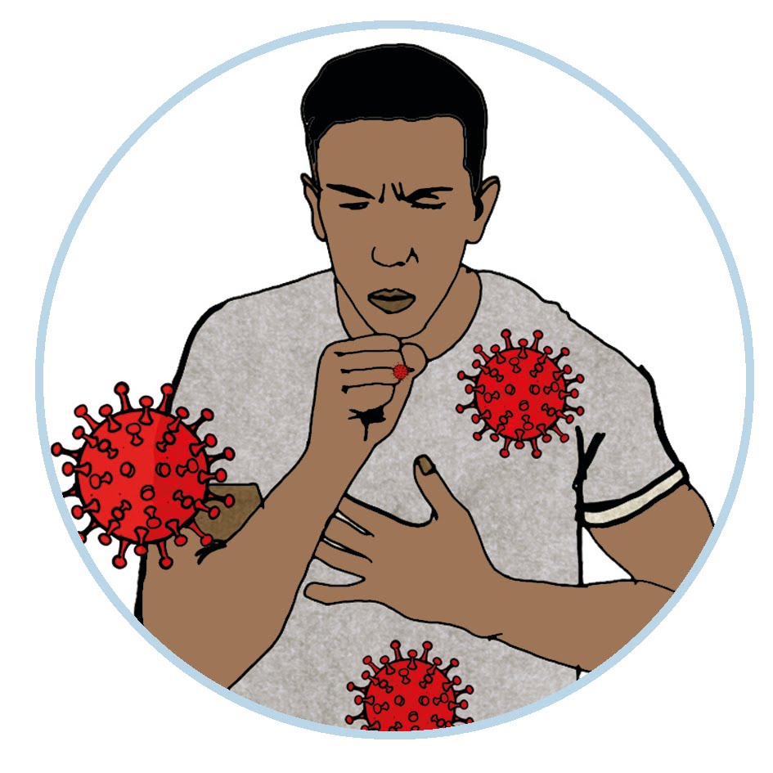
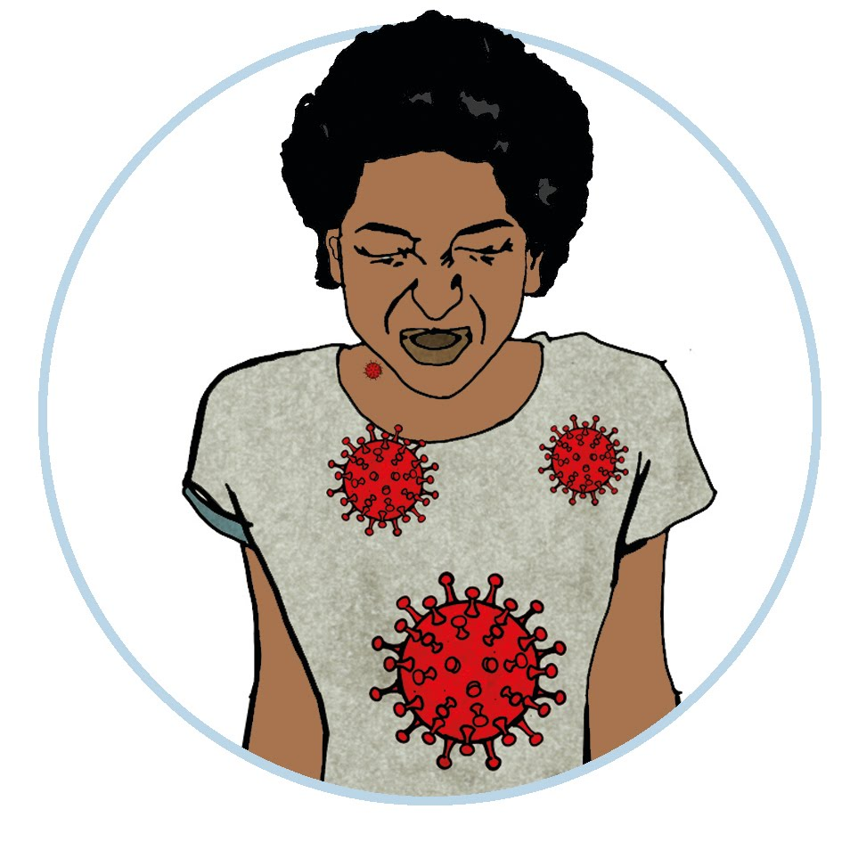
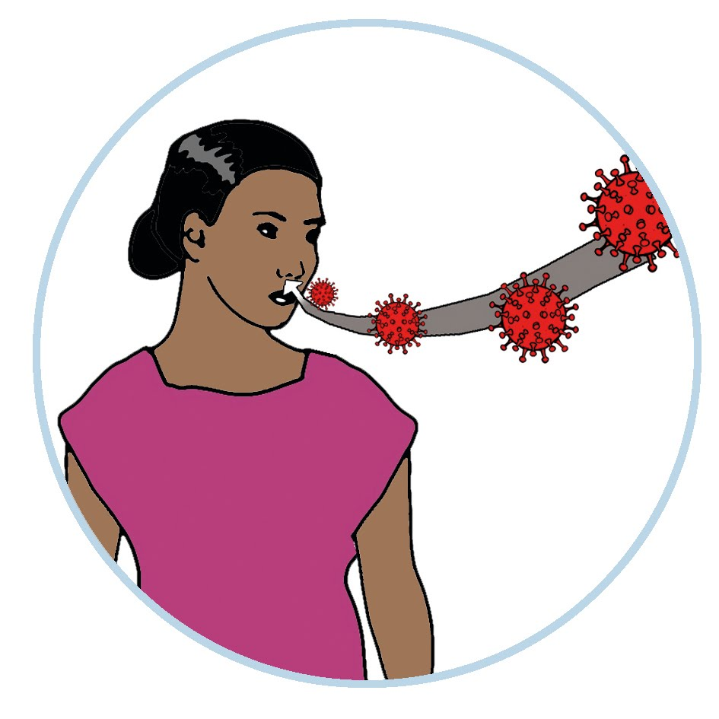
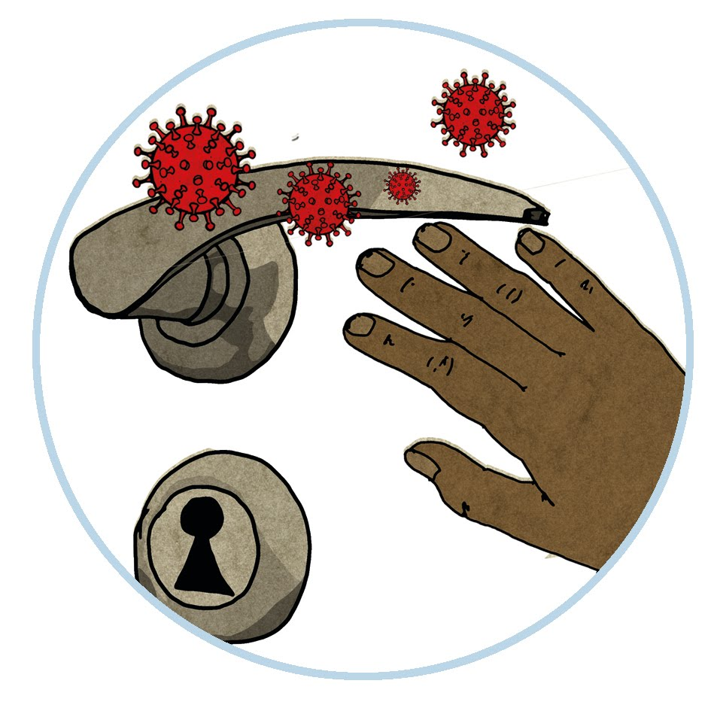
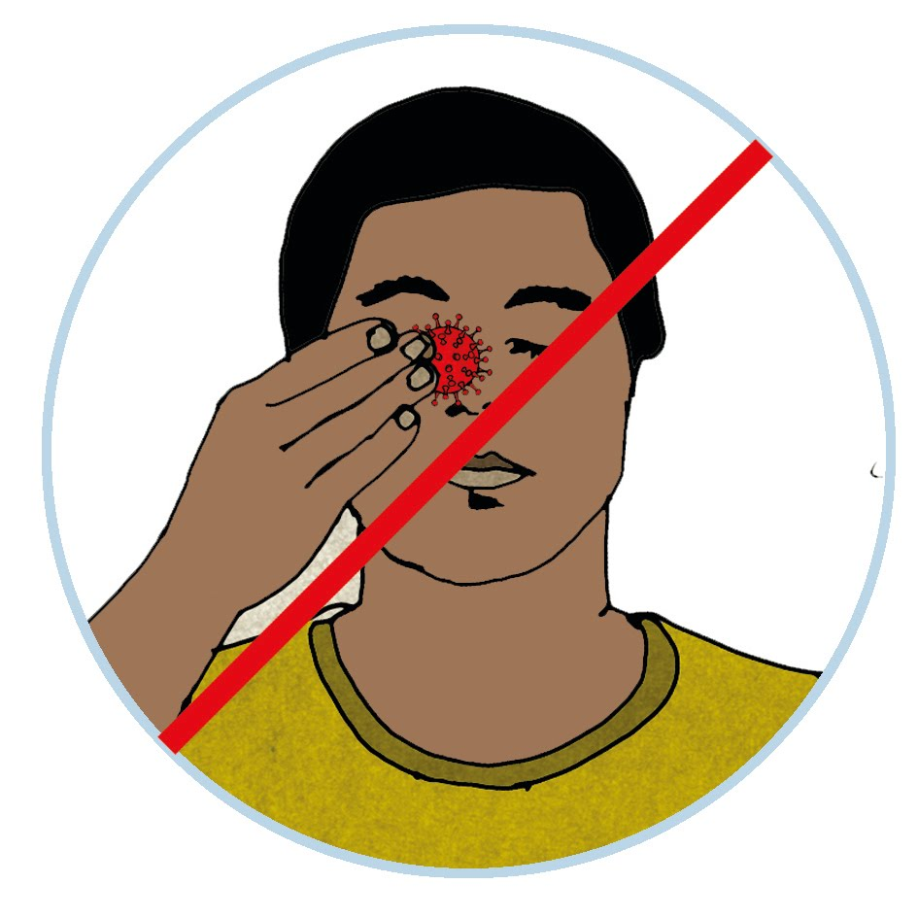
How does it spread from person to person?
Like the flu or other breathing diseases, when a person has COVID-19, they generally experience symptoms like the flu.
Because the virus affects a person’s respiratory system (lungs), the virus mainly spreads from person to person through respiratory droplets; small particles that are released when an infected person coughs or sneezes.
A well person can become infected with the virus if they breathe in these droplets or if they touch surfaces and objects where the virus has landed and then touch their faces. This is because the virus can enter a person’s body through their eyes, nose and mouth.

Slide 5
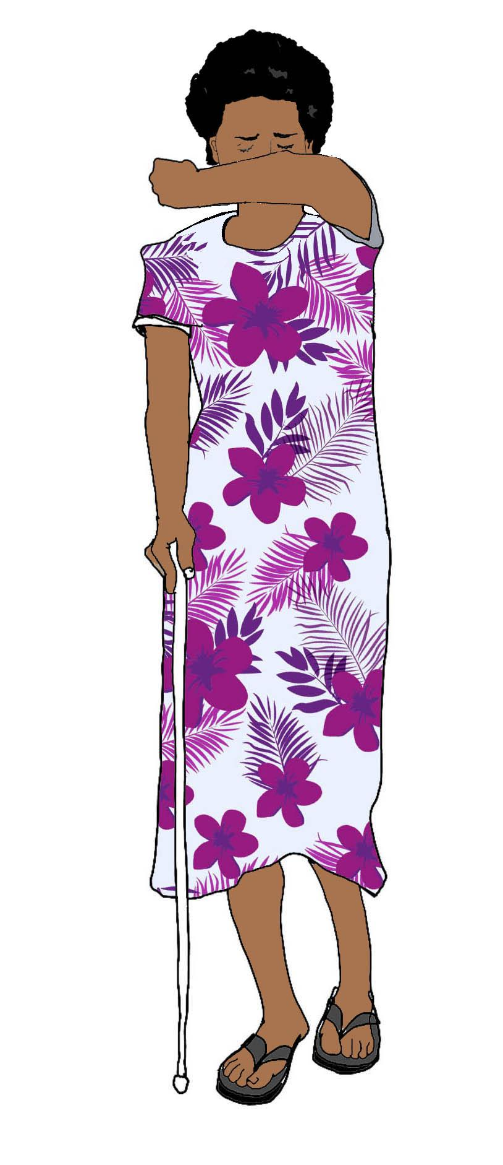
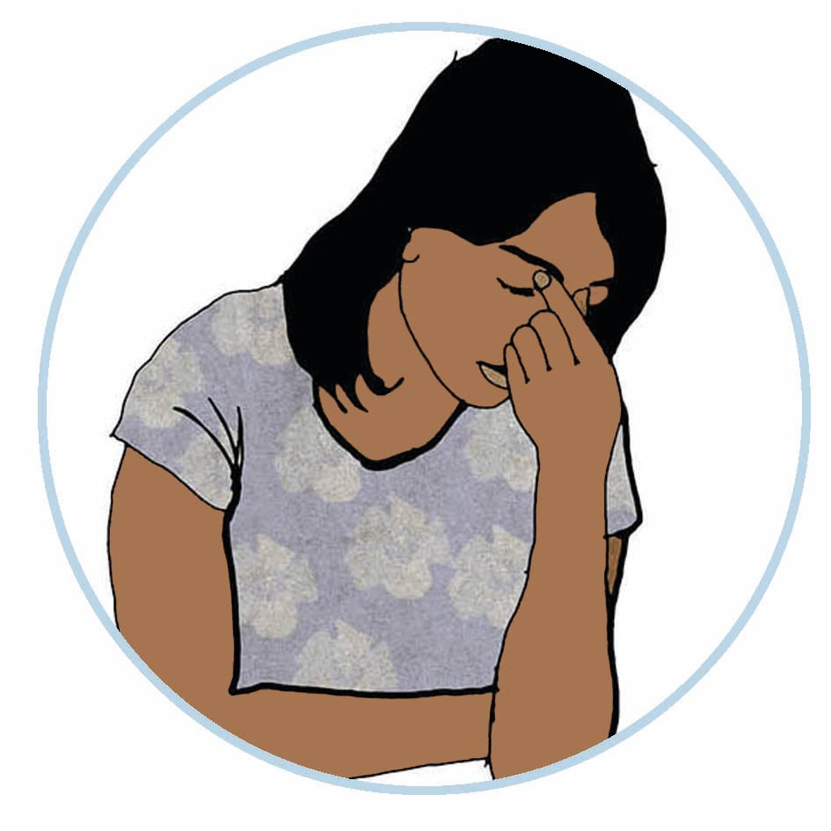
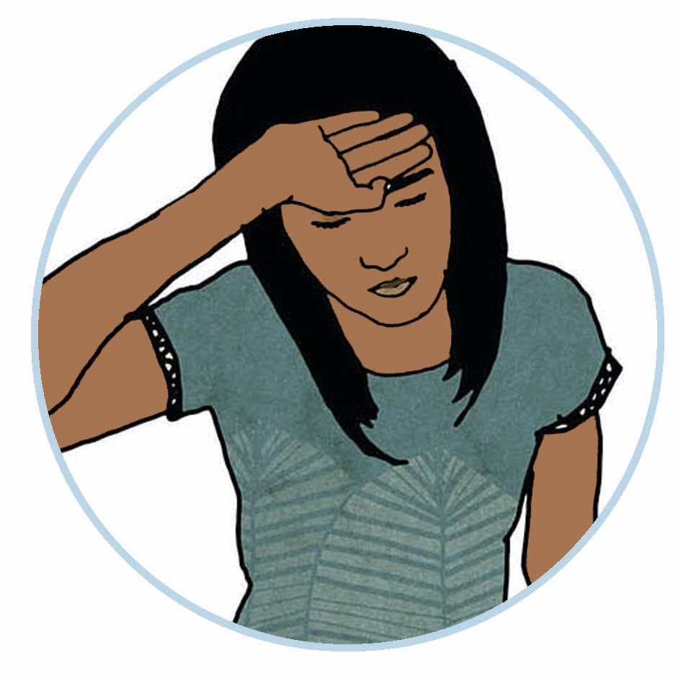
What are the signs and symptoms of COVID-19?
It is important everyone knows the signs and symptoms
of COVID-19 .
The most common symptoms of COVID-19 are:
Extreme tiredness (fatigue)
Fever
Dry cough

Slide 6
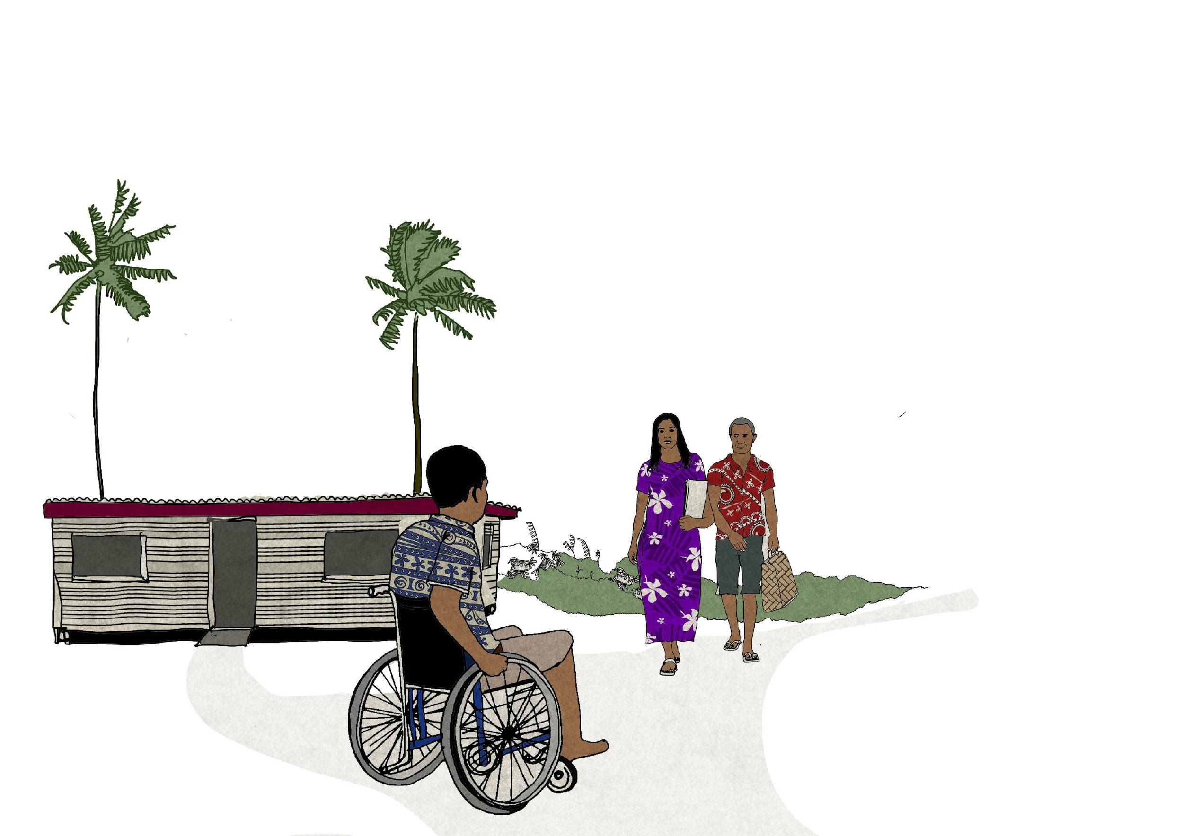
Other symptoms may include loss of taste and smell, aches and pains, nasal congestion, headache, conjunctivitis (red eyes), sore throat, diarrhoea, and/or a rash on skin or change of colour of fingers or toes.
These symptoms are usually mild and begin gradually. A person generally develops symptoms 5 to 6 days after they are infected with the virus, however it can happen anywhere from 1 to 14 days after a person is infected.
Some people may not present any symptoms or very mild symptoms.
Can COVID-19 be caught from a person who has no symptoms?
Most people seem to catch COVID-19 from other people who are developing or have symptoms and have been in close contact for over 15 minutes, for example sitting next to one another or sleeping in the same room.
This is why it is important to keep track of the places you have visited and the times, as this information will assist health authorities to find and help people whom may have come in close contact with a person who has COVID-19.

Slide 7
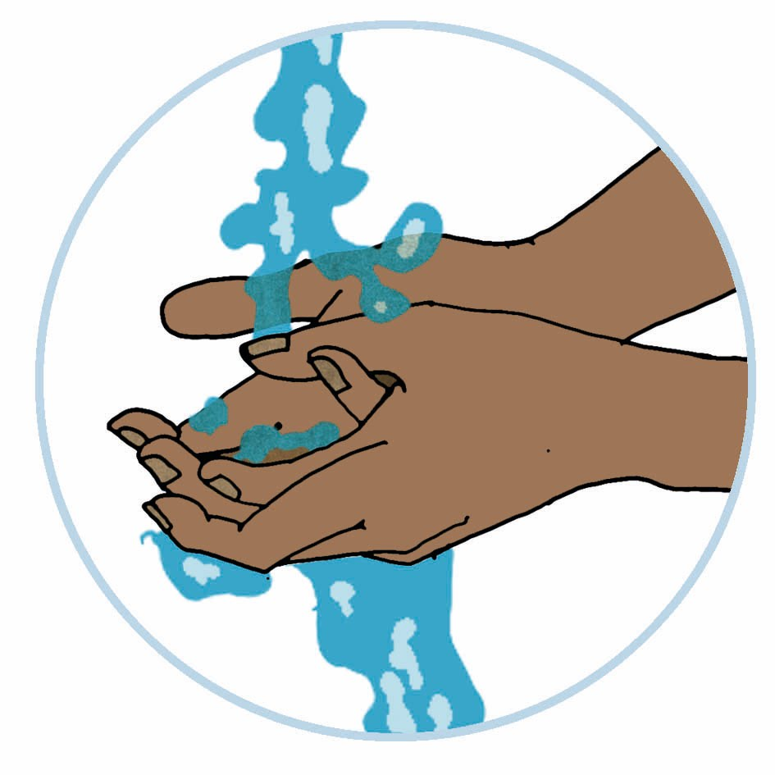
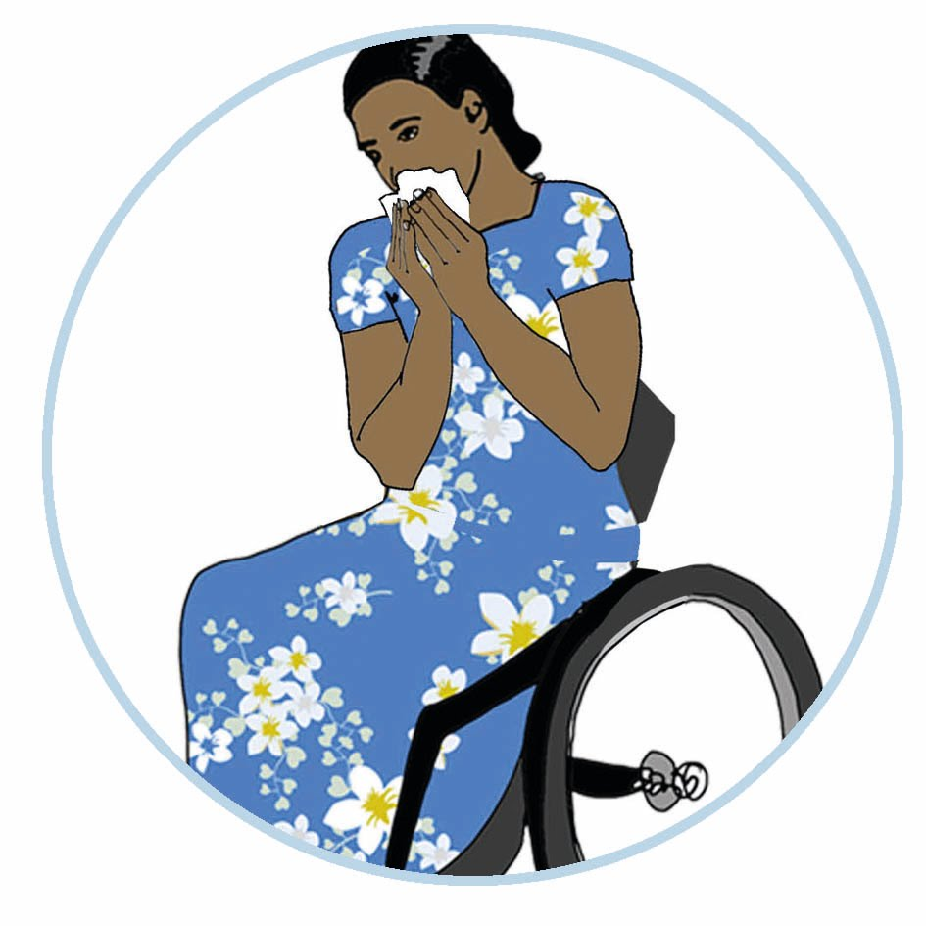
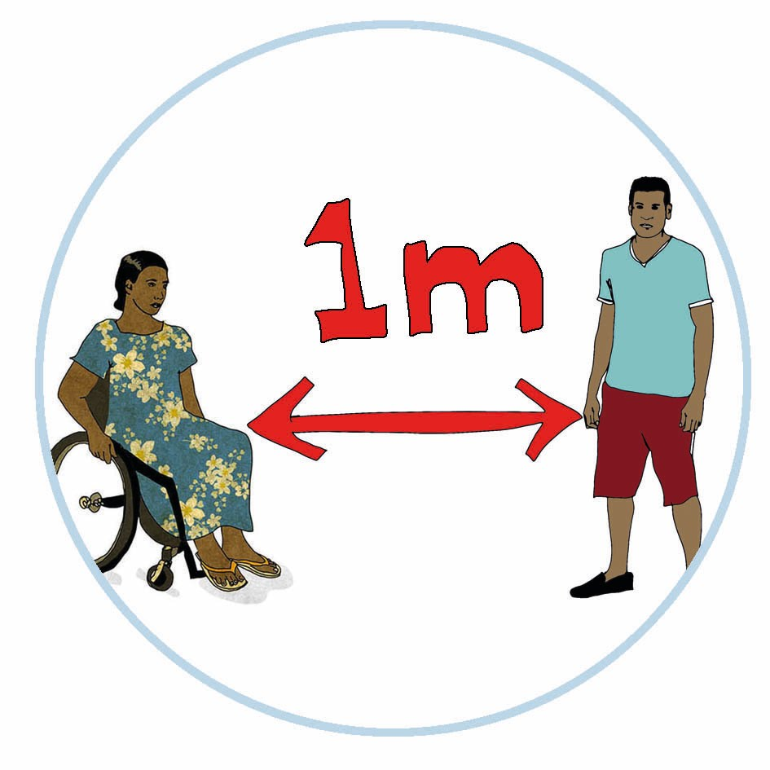
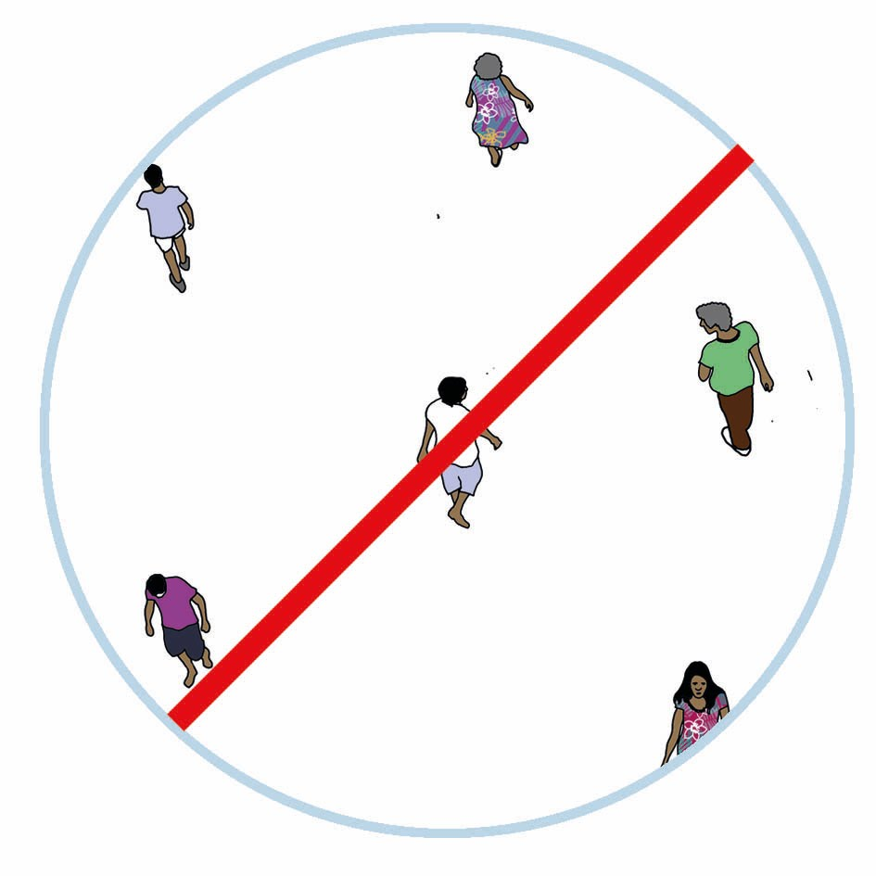
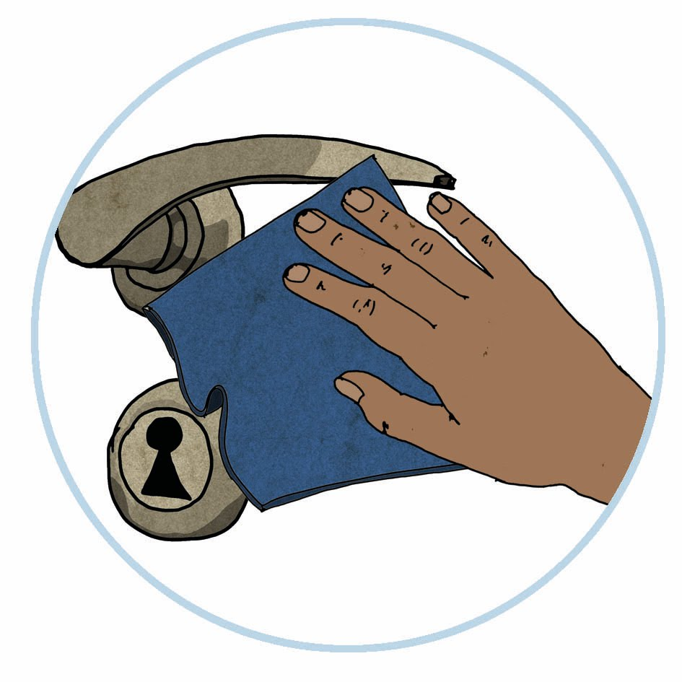
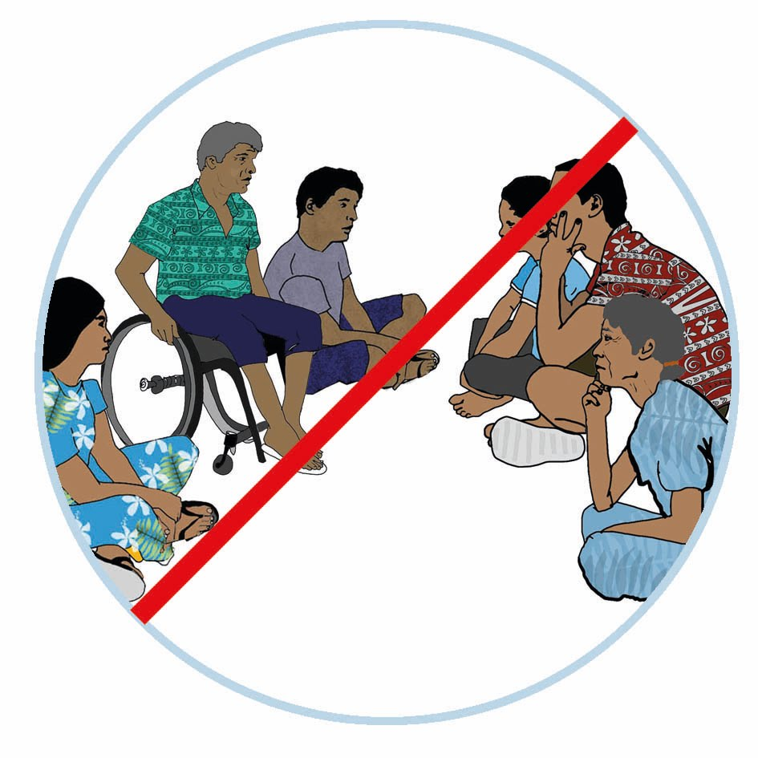
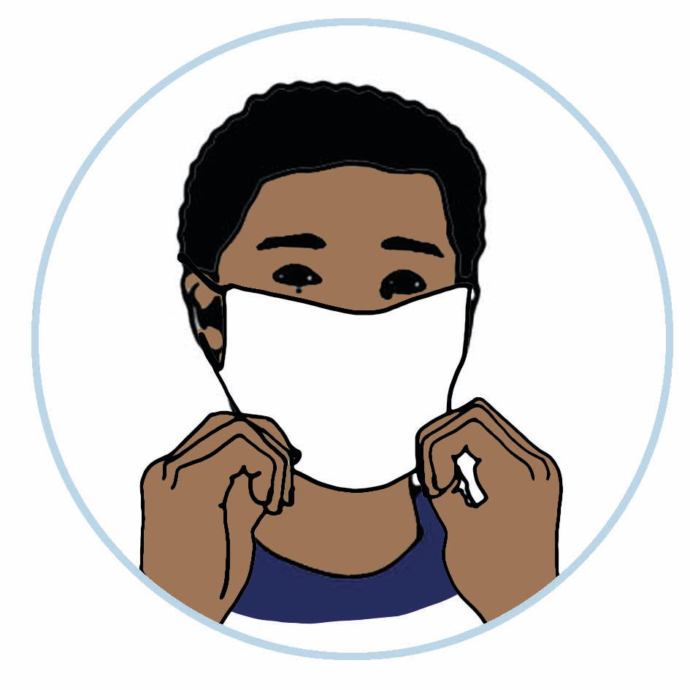
B
How you can protect yourself from COVID-19
Because of the way the virus spreads, there are some simple actions you can do to help protect yourself and others from COVID-19.
If there is an outbreak or cases of COVID-19 in your country, these simple actions can help protect you and also assist in keeping your family safe from the virus.
Information for a person with disability
Clean your hands regularly with soap and water or use hand sanitizer.
Always cough or sneeze into your elbow (not your hands!). If you have tissue, use this and discard after use. Clean your hands after.
Keep at least 1 to 2 metre distance from others and avoid shaking hands, hugging and kissing. If you require assistance, ensure that your personal assistant is practicing good hygiene.
When outside the home, limit your time in closed or crowded places, like markets or elevators.
Regularly clean and disinfect objects and surfaces that are touched frequently, like door handles, assistive devices and your mobile phone.
Avoid touching your face (eyes, mouth and nose) with unclean hands.
Postpone or join remotely (e.g. via video or mobile) social gatherings and family meetings.
Wear a mask if you can’t practice physical distancing, or when outside the home.

Slide 8
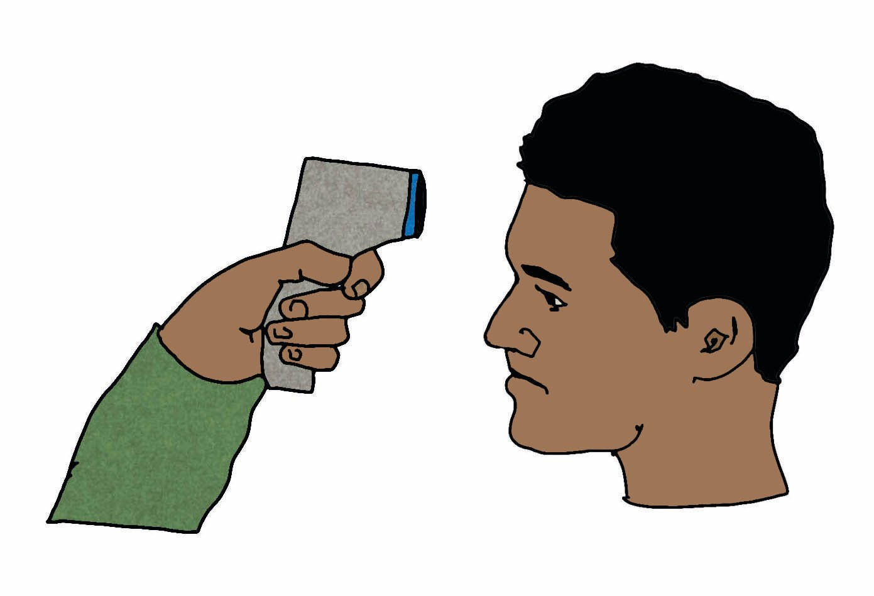
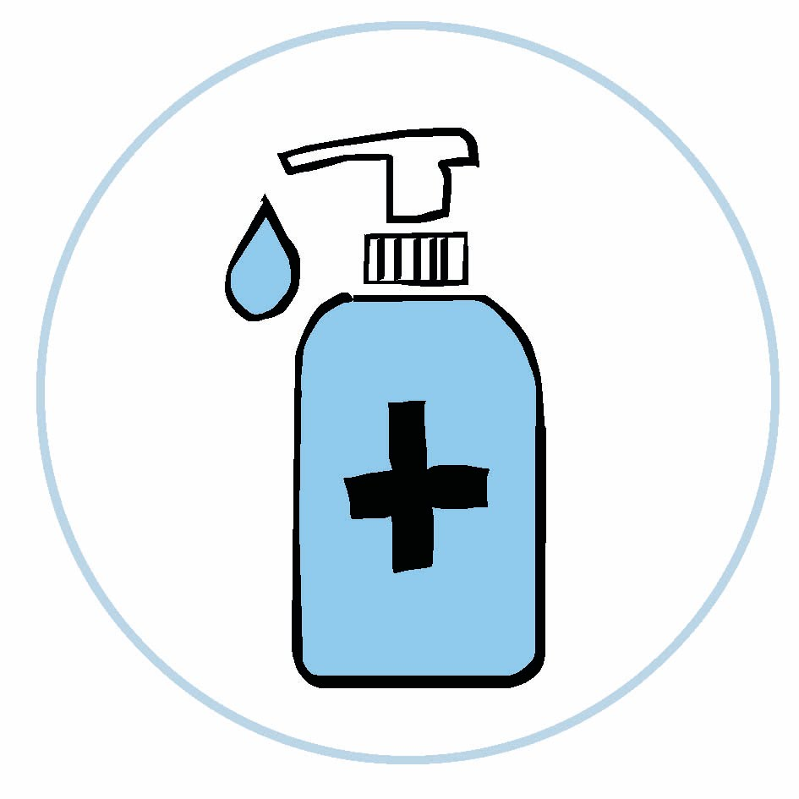
Information for Personal Assistants
Always follow your employer’s/organisation’s COVID-19 occupational health and safety requirements, including regularly monitoring your health and temperature, and not providing care to people with disabilities if you are feeling unwell or have a temperature over 37.5° C.
Clean your hands regularly with soap and water or use hand sanitizer before and after assisting people with disabilities.
Always cough or sneeze into your elbow (not your hands). If you have tissue, use this and discard after use. Clean your hands after.
Regularly clean and disinfect objects and surfaces that are touched frequently, like door handles, wheelchair hand grips, as well as places or surfaces touched by people with disabilities.
Avoid touching your face (eyes, mouth and nose) with unclean hands.
Ensure that you practice preventative measures and proper hygiene before, during and after assisting people with disabilities.
Wear a mask if you can’t practice physical distancing, especially when providing care to people with disabilities.

Slide 9
Information for Families
As a family, especially as members of your family have a disability, it is critical that you practice the family members. By taking these steps, you are reducing the risk of getting sick and spreading it to other family members, if there is an outbreak of COVID-19 in your country.
Clean your hands regularly with soap and water or use hand sanitizer.
Always cough or sneeze into your elbow (not your hands). If you have tissue, use this and discard after use. Clean your hands after.
Keep at least 1-2 metres distance from others and avoid shaking hands, hugging and kissing.
When outside the home, limit your time in closed or crowded places.
Regularly clean and disinfect objects and surfaces that are touched frequently, like door handles and your mobile phone.
Avoid touching your face (eyes, mouth and nose) with unclean hands.
Postpone or join remotely (e.g. via video or mobile) social gatherings and family meetings. Limit visitors to the home.
Develop a COVID-19 Household Action Plan. This tool will help your family plan how they can plan and respond to COVID-19.

Slide 10
How to respond if you suspect you may have COVID-19?
If you have any of these symptoms, keep yourself away from others and immediately contact <insert COVID reporting line> or visit your local fever clinic/health facility.
If you rely on a guide/assistant, and if possible, wear a face mask, wash your hands and keep your distance from others while waiting for medical help.
If you are feeling unwell, stay home. It’s very important you avoid other people and do not catch public transportation like the buses and taxis, as this can help prevent the virus spreading to others.
If you are living in an extended family setting, you or your family may need to isolate in the home. See if there is a room or place where only those acting as personal assistants can come into close contact with the person with disability.

Slide 11
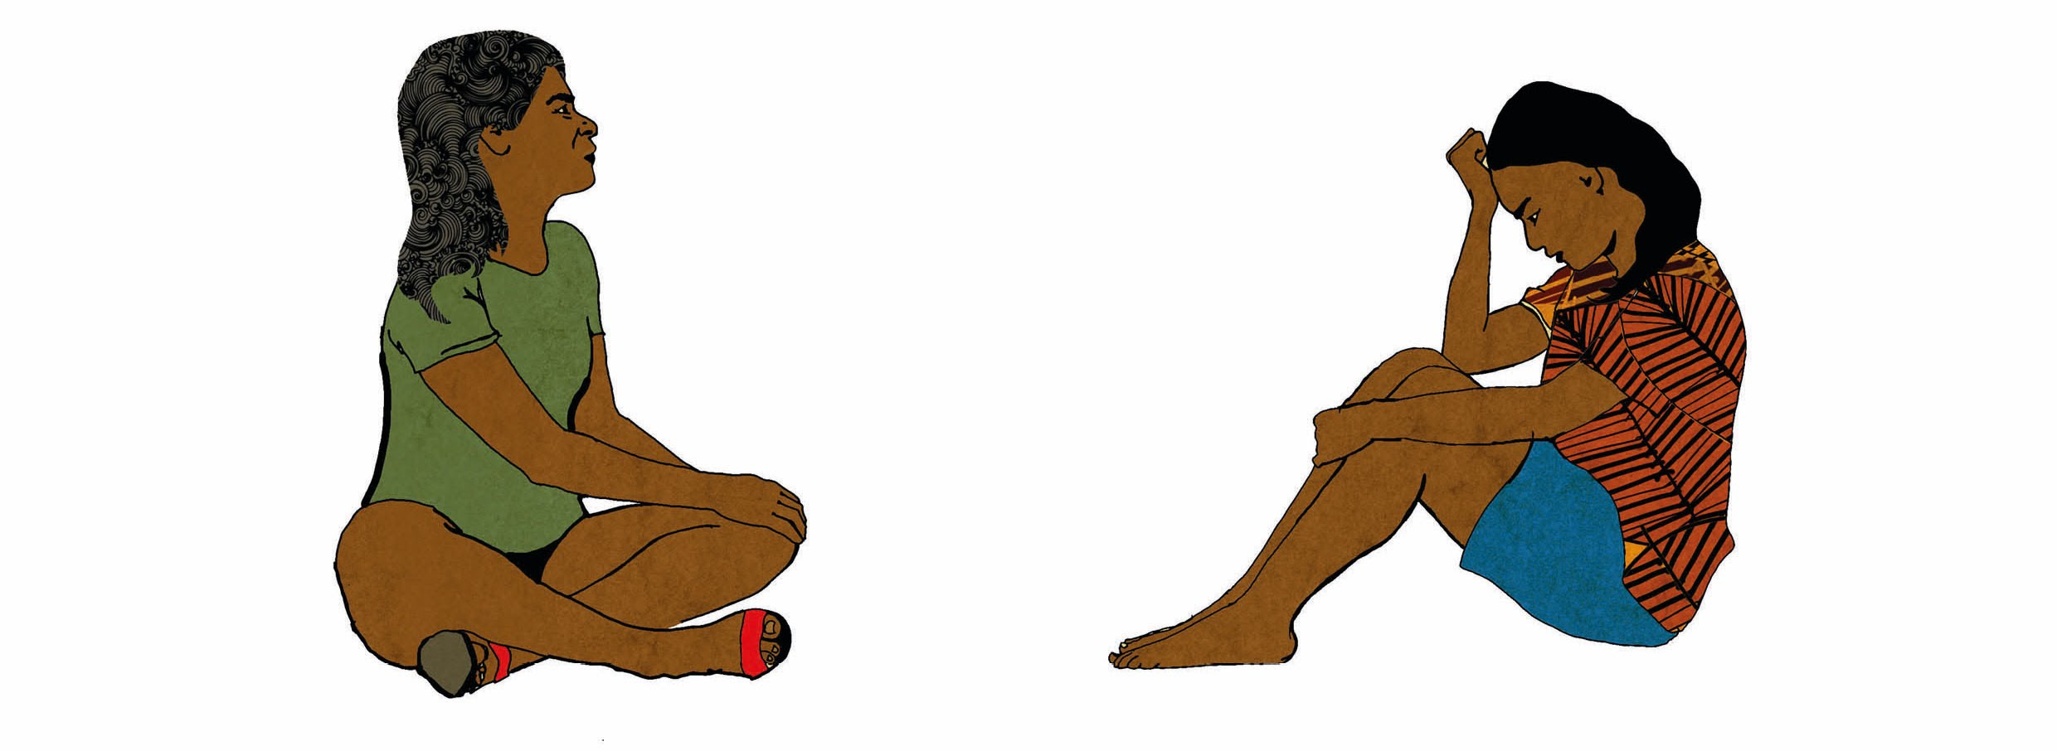
It’s normal to feel some stress and anxiety - how you can help lessen your anxiety
Many people are dealing with many new pressures as a result of the pandemic, including fear of becoming ill, loss of jobs, having to take care of other family members, and uncertainty for the future.
During this time, it is important that we continue to support one another and be aware of our own and others’ mental health.
Have a COVID-19 Household Action Plan.
Talk to others about how you will keep each other safe and how you will manage if someone gets sick.
Stay in contact regularly with friends and family (remotely, if possible).
There are lots of ways you can look after your wellbeing and it’s really important that you do. Here are some ideas of things you can do to help you feel good and keep connected.
Keep to your routine as much as possible.
Take care of your health.
Do things that you enjoy.
Try not to watch too much news.
Ask if you need help.
What does it mean for me, as a person with a disability?
It may mean that your care provider/ friends / family may not be able to visit you, depending on advice from the government, and if they do visit you, they may need to be distanced, and do things differently to reduce the risk of you getting COVID-19.
It will need to adopt the personal protective measures, including regularly cleaning of your hands and wiping down frequently touched surfaces like your mobility devices, mobile phone and other. .
You may have to change your schedule and avoid going out as much as you used to.
Schedule regular video calls or calls with your doctor/counsellor/service provider and friends with disabilities.
Look for other ways to remain active and healthy, both mentally and physically.

Slide 12
C
Develop your COVID-19 Household Action Plan
It is important that we prepare now for COVID-19 because if there are cases in the country, it could spread very quickly and affect many people.
If lockdowns and other restrictions are put in place to stop the spread, we need to ensure that communities - and you - have plans in place to access critical supplies and resources.
To make sure that we are ready, let us draw up a COVID-19 Household Action Plan.
What am I planning for?
Plan to stay at home for long periods of time.
Plan what you will do if you or someone who support you has COVID-19 symptoms.
Plan for if another emergency happens, like a cyclone.
Think about:
what you do every day, where you do it and who you do it with
your role and responsibilities to others (e.g. partner, children, parents)
who you get information from, and how can you continue to get information
how you will manage your support needs while isolating
how you can reduce the risk of catching COVID-19

Slide 13
Action Plan
The COVID-19 Household Action Plan is for the person with disability. This plan should be developed with the person with a disability, and their support network – family, friends, neighbours.
It’s important the information included is factual and kept up-to-date. Please tick if these activities have been achieved.
What you can do to prepare for COVID-19.
Make a list of the medication you would need to have on you. Ensure that it is sufficient for 14 days.
Check your supplies at home and see if you need to stock up again. It is important to ensure that your necessities are stocked up for at least two weeks.
Check your First Aid Kit to make sure it is stocked with non prescription medication like pain killers, fever reducers, vitamins and cold medication.
Look up on alternatives for your therapy sessions or specialist visit. Consider home based visitations.
Have your COVID-19 Household Plan ready and reminders around the house. Use coloured paper to stick reminders in various places frequently used around the house.
Ensure that your supply of antibacterial soap, hand sanitizers, disinfectant and clean towels and rags are available for 14 days.
Have backup batteries, canned foods, candles as well as cleaning utensils and masks (medical or fabric) to last for 14 days.
Have your emergency contact numbers printed and posted in a common area as well as on you at all times.
Ensure your doctor, therapist and personal assistants are in contact, even remotely.

Slide 14
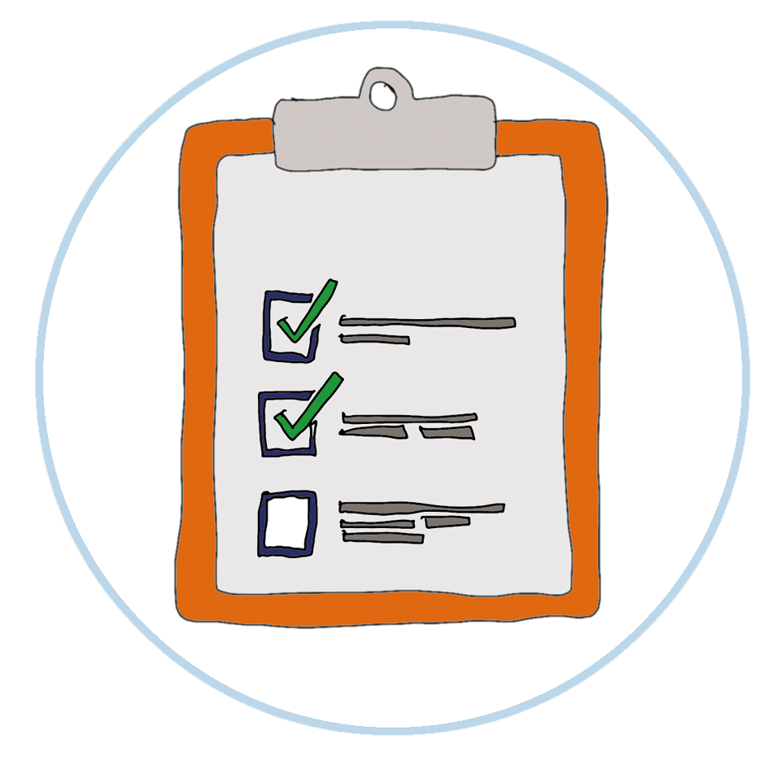
My Plan
My contact information and how I like to communicate
My phone number is: ________________________________________________________
My phone service company is: (adapt as relevant for your country)
Telecom
Vodafone
Digicel
Inkk
Others __________________________
I keep in touch with my friends and family by using these apps on my phone
Facebook Messenger
WhatsApp
Viber
My Medical Needs
I have ___________________________________________________________ impairment.
This means that I am ________________________________________________________
I need specific medication. They are listed below:
______________________________________________________________________
______________________________________________________________________
______________________________________________________________________
______________________________________________________________________
In case these medication run out, they can be found at
______________________________________________________________________
I will always need/do not need to have a personal assistant with me. (please circle)

Slide 15
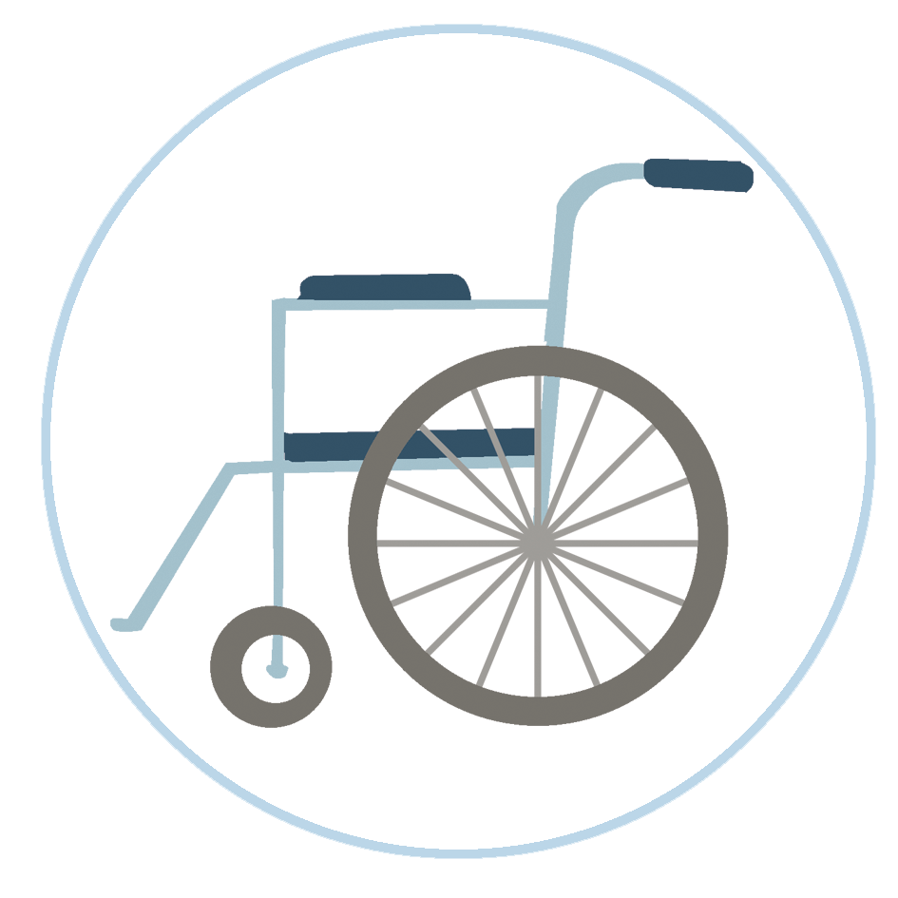
My Assistive Devices and dietary needs
My assistance devices
My assistive mobility device is ___________________________
I regularly wipe down my mobility devices using disinfectant, clean water and a clean piece of rag.
Wiping down happens whenever I return from being outdoors or when there is a change over of personal assistants.
To wipe down my mobility device, I do the following steps:
dissolve disinfectant is a basin or bucket of water (disinfect with 0.1% bleach solution)
use a clean rag and wet it
wipe the areas which are touched or being used regularly
ensure that all the areas which are exposed are wiped down - these steps to be undertaken where possible without damaging the device.
My Dietary Needs
For my disability, there are certain foods I do not eat. They are listed below:
______________________________________________________________________
______________________________________________________________________
______________________________________________________________________
If I have a reaction to the food being served to me, the following actions should be done:
______________________________________________________________________
______________________________________________________________________
______________________________________________________________________

Slide 16
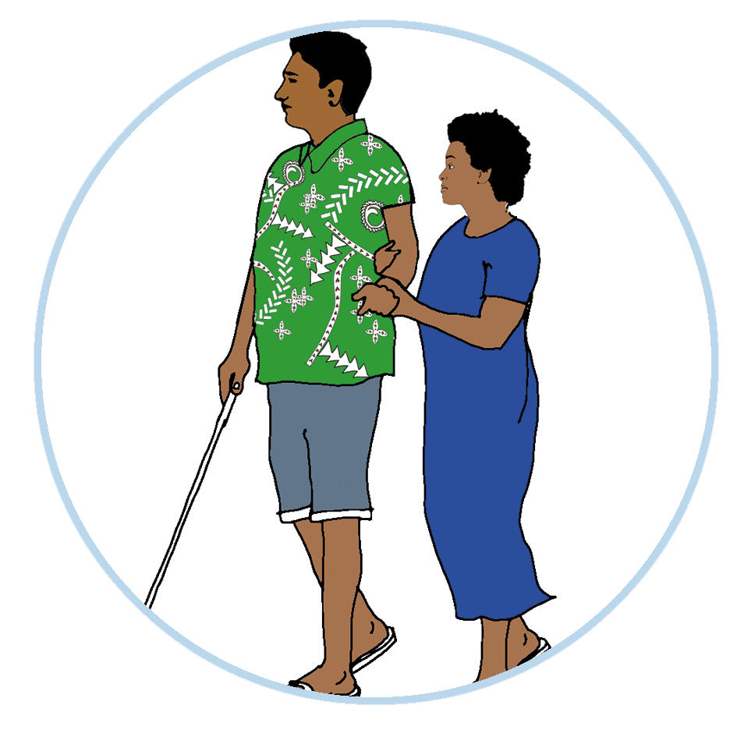
My Personal Support
The support I need each day is:
______________________________________________________________________
______________________________________________________________________
My support provider is _______________________________________________________
My support worker is ________________________________________________________
The support that is most important to me and that I must have:
_______________________________________________________________________
_______________________________________________________________________
_______________________________________________________________________
_______________________________________________________________________
_______________________________________________________________________
In an emergency I will call: _____________________________________________________
I have clear COVID-19 personal support instructions for my support staff, and any new support staff.
I’ve told my COVID-19 care instructions to all of my support staff.
I talked about my plan with my emergency contact.

Slide 17
Getting out and about
Transportation (in times of essential need)
I will only go out in emergencies or when I have no other choice but to get supplies.
I will try and stay home if I can to reduce the risk of catching COVID-19.
I will ask friends or family to drop off items or food instead of me going at.
When I travel to places I use
________________________________________________________________________
My support person who helps me with travel is ____________________________________
I have health appointments like blood tests and therapy that I have to go to.
Can I still go?
Some people still have to go to important appointments.
You should call ahead to make sure it is safe to go. Ask if there is anything different you have to do when you arrive.
Some appointments may take place over the phone or over video. Ask your support person to arrange this with you if you need help.

Slide 18
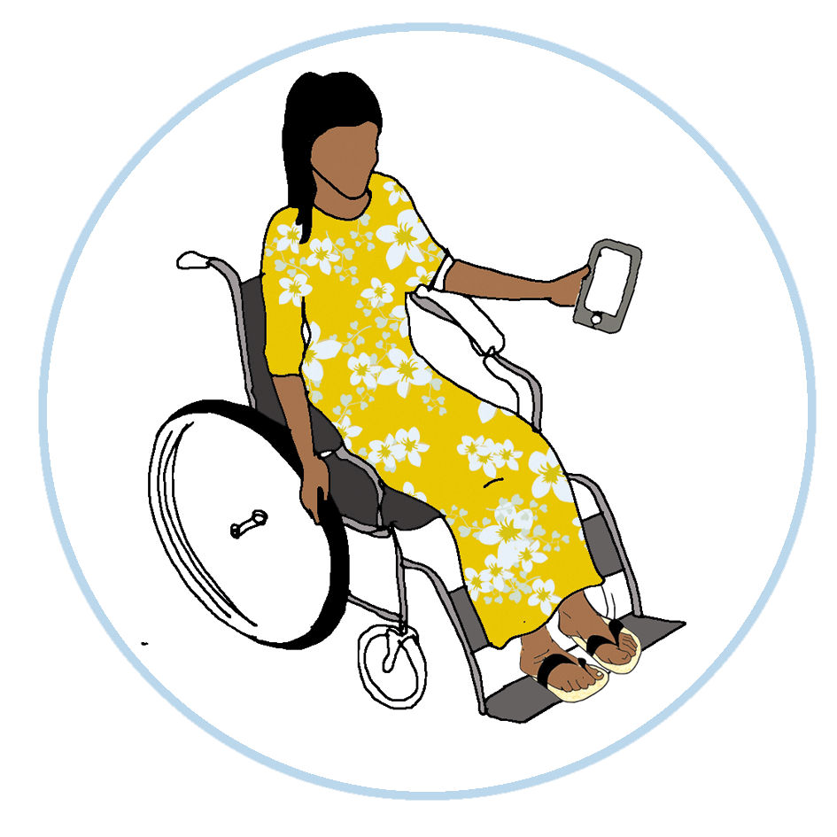
When I go out:
I take my phone with me when I leave the house and make sure it is charged.
I call my family, friends or support provider to let them know I plan to leave the house especially when the COVID-19 alert is still in place.
I know the address of the house, shop, supermarket or safe place I am going to.
I make sure my bus card has enough money on it or I have some money on me.
If I can’t use the same route as usual, I know the different routes to travel.
I’ve asked my support person for help to learn a new route or if I have questions.
When I return home, I make sure to wash my hands and that my personal assistant also washes his/her hands.
I/my personal assistant cleans and disinfects my mobility device once I return home.

Slide 19
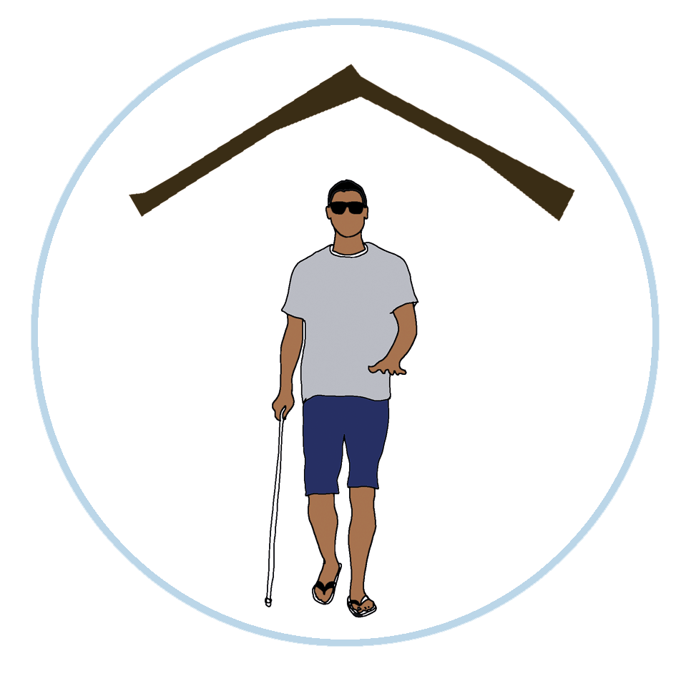
At home
Living Arrangements
I live with __________________________________________________________________
My address is ______________________________________________________________
My support provider’s number is _______________________________________________
If I am unwell I will call _______________________________________________________
I can put a STOP sign on the door to let people know I am unwell or if I
have COVID-19 symptoms. This is a way of isolating myself until the
health authorities arrive.
I keep the house clean to stop the spread of germs.
This includes:
Cleaning with detergent and wiping down the table tops, railings, window sills, sinks, toilet, etc with disinfectant
regularly sweeping and vacuuming
having hand sanitisers in places that I can reach
I cannot isolate myself from other people because I need help with personal care.
What can I do?
You can talk with the people who support you and your family.
You can ask the people who support you to
wash their hands regularly
cover their nose and mouth with a tissue or bent elbow when coughing or sneezing
avoid touching their face, nose and mouth
not shake hands
stay home if they are unwell.
Physical distance as much as you can.

Slide 20
I need people to do my shopping and help me with my cooking and cleaning.
Can they still help me?
Yes! Your support worker can still help you. But you both need to make sure you follow the simple personal protective measures to minimise the risks of catching COVID-19 or spreading it.
You might have to arrange new times for your support.
Talk to your personal assistant or supporter about how they can help reduce your risk.
Your wellbeing
How do I look after my wellbeing?
There are lots of ways you can look after your wellbeing and it’s really important that you do. Here are some ideas of things you can do to help you feel good and keep connected.
Use this COVID-19 Household Action Plan.
Keep to your routine as much as possible.
Take care of your health.
Do things that you enjoy.
Keep talking to your friends and family.
Try not to watch too much news.
Ask if you need help.

