Slide 1
Eliminating barriers for persons with disabilities in relation to the preventative measures for COVID-19
To be read in conjunction with the disability COVID-19 guidance for individuals
The following is additional to the Guidance Material on COVID-19 preventative behaviors for all disabilities

Slide 2
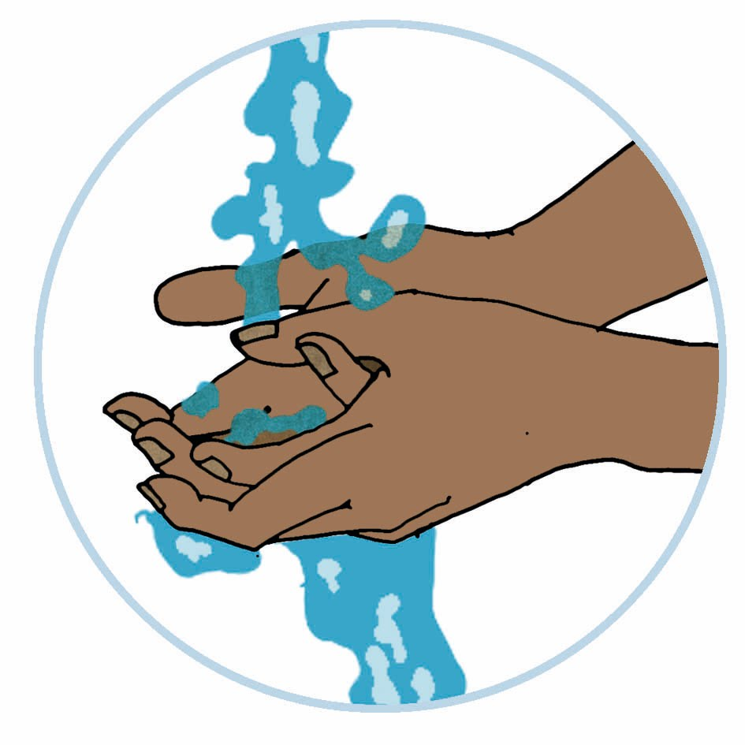
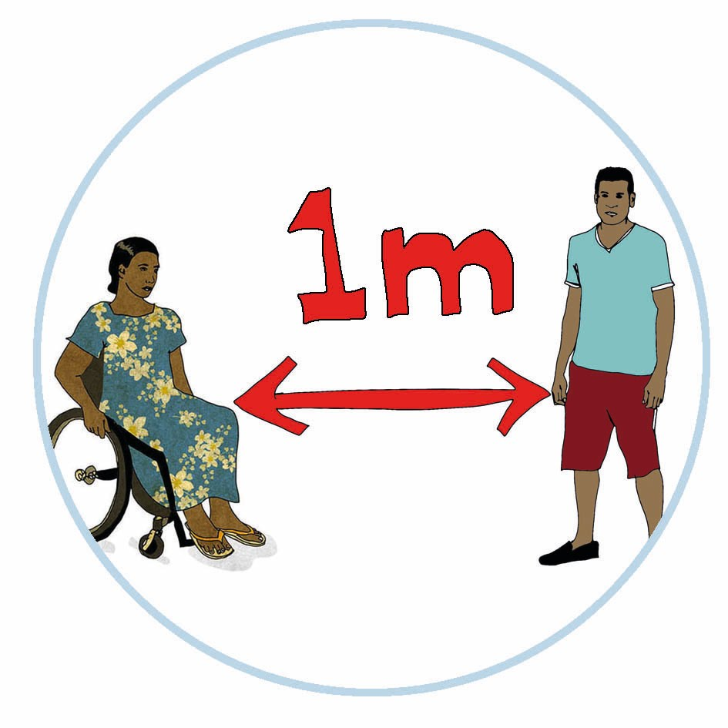
Eliminating barriers for persons with disabilities in relation to the preventative measures for COVID-19
Persons who are blind or who have low vision:
Handwashing
Ensure that you wash your hands before and after using your assistive devices (e.g. white cane, magnifying glasses and reading lens).
If you touch walls, tabletops, doors, and other objects, you can pick up the virus. Ensure that your sighted guide practices safe and regular hand washing before assisting you with the same procedures.
Maintaining 1-metre distance
Maintaining a one-meter distance is not possible if you use a sighted guide, therefore ensure that your sighted guide always maintains a one-meter distance when not with you.

Slide 3
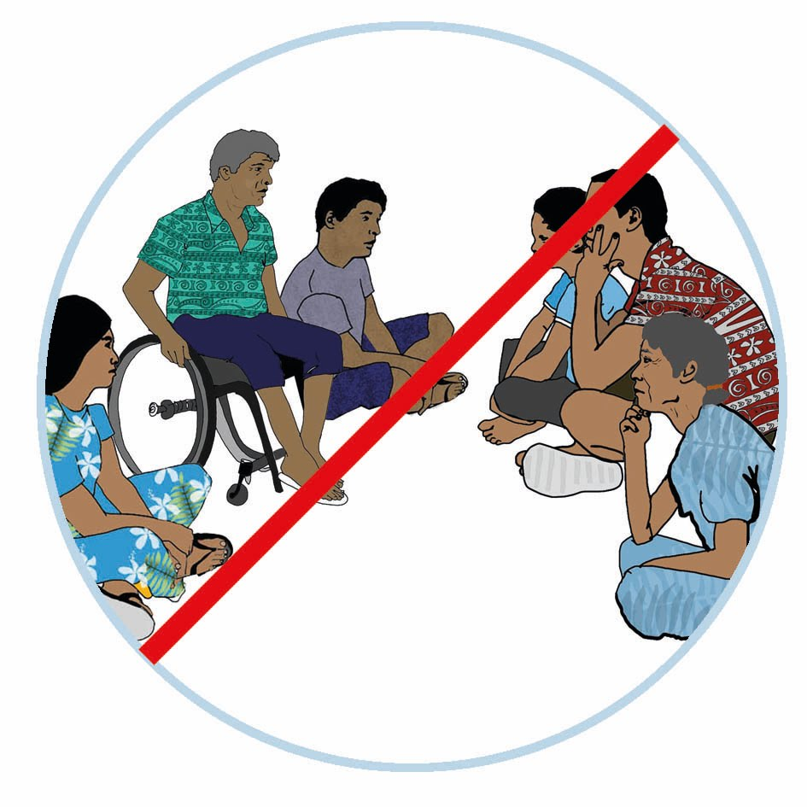
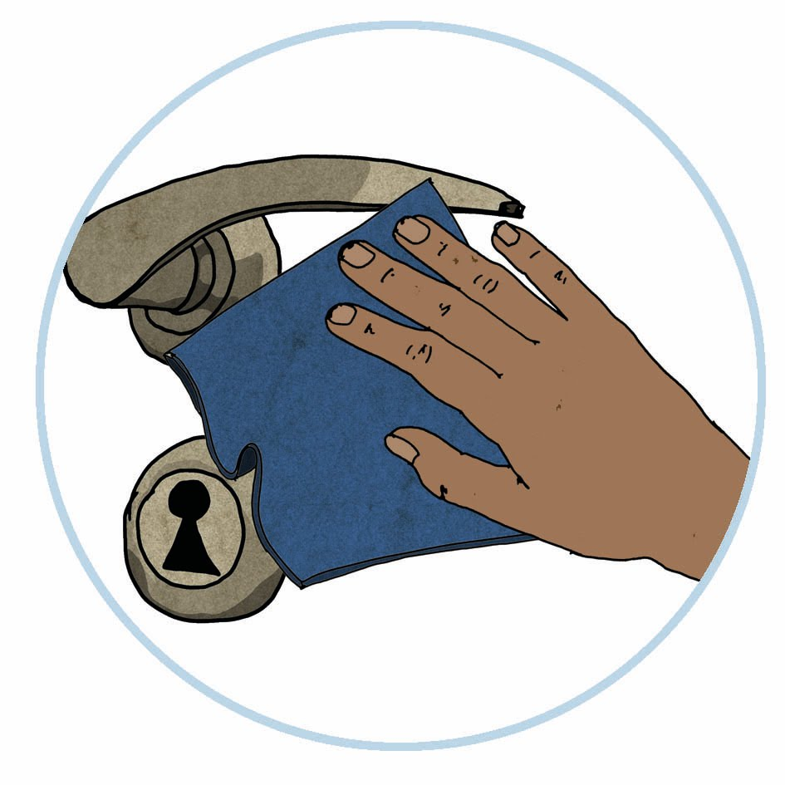
Eliminating barriers for persons with disabilities in relation to the preventative measures for COVID-19
Persons who are blind or who have low vision: CONTINUED
Limiting time spent in enclosed or crowded spaces
For persons with disabilities, to ensure their safety, it is advisable that support is provided for shopping and banking, etc.
Always ensure that a family member or sighted guide practices safe distancing and ensure that they are to restrict themselves from overcrowded spaces with or without your presence.
Cleaning frequently touched objects and surfaces
Ensure that your personal assistants and sighted guides sanitize the areas of your home that you spend the most time in.

Slide 4
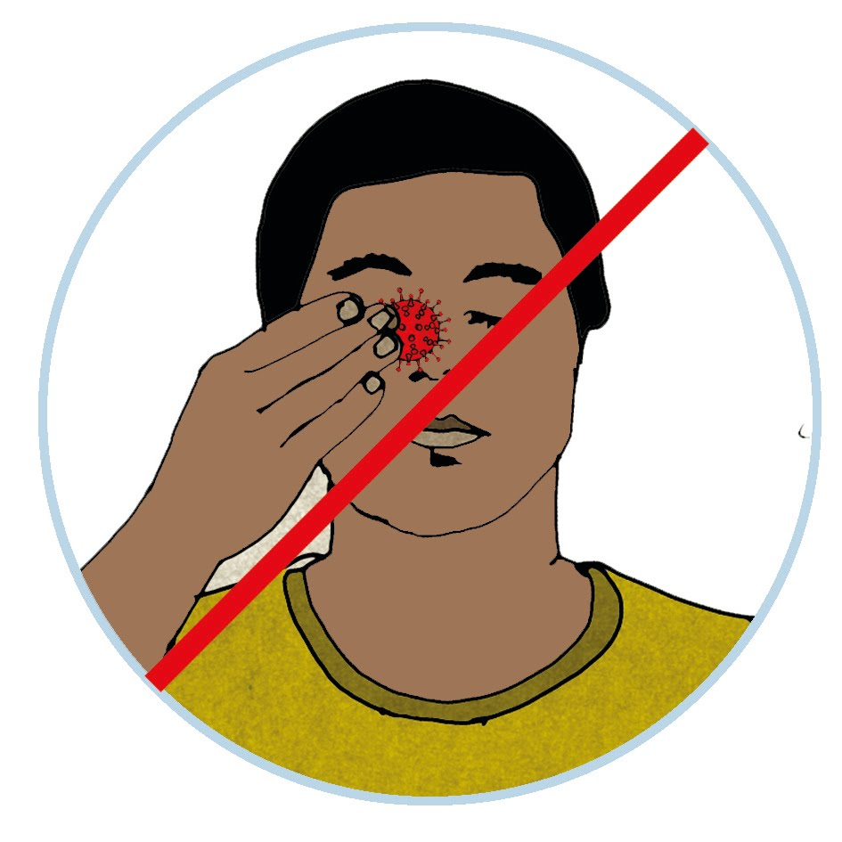
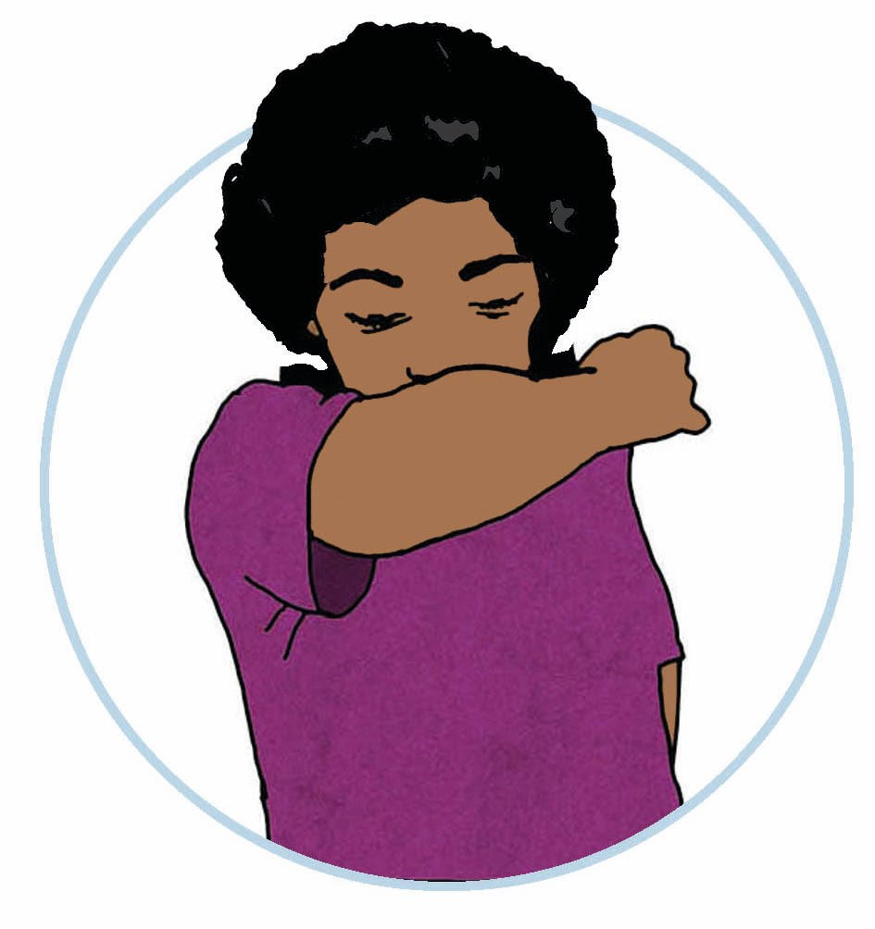
Eliminating barriers for persons with disabilities in relation to the preventative measures for COVID-19
Persons with psychosocial and intellectual disabilities:
Cleaning frequently touched objects and surfaces
Make a list of places which you touch a lot so that you will have a reminder of surfaces to wipe down.
Avoiding touching our faces
Constant reminders using pictures is important to remind you not to touch your face.
Sanitize your hands at all times.
Covering sneezes and coughs
Use a clean handkerchief or a tissue to cough or sneeze into and dispose it straight away in the bin.

Slide 5
Eliminating barriers for persons with disabilities in relation to the preventative measures for COVID-19
Persons with psychosocial and intellectual disabilities: CONTINUED
Avoiding touching our faces
Wash your hands or always carry a hand sanitizer with you to ensure your hands are kept virus-free.
Ensure that your reading glasses, shades and magnifying lenses are wiped or disinfected properly before and after putting on.
Handwashing
There should be clear signs and images on proper handwashing procedures in your home.
The use of colors and pictures are important, therefore use these as part of the reminders in your routine posters at home.
Ensure that hand washing items are kept at the same place with clear labels.
Maintaining one-metre distance
When you go out of your house, make sure that you maintain a one-metre distance from other people.
There needs to be a set of clear images to demonstrate how to maintain one-metre distance.

Slide 6
Eliminating barriers for persons with disabilities in relation to the preventative measures for COVID-19
Persons with physical impairment
Handwashing
Make sure that you wash your hands before and after using your wheelchair, crutches or walking frames, etc. Your personal assistant will assist you with this action depending on the severity of your disability.
Ensure that sinks and hand basins are also within reach. This also for those with short stature.
Alternatively, when soap isn’t readily available, you can also use an alcohol-based hand sanitizer to clean your feet.
For those persons with physical impairment without upper limbs, (limbs up to the elbow) and those who use their feet:
Make sure that you wash your feet with soap and water several times a day for at least 20 seconds, especially before and after meals.
For those persons with limbs up to the elbow or those with one hand as well as those with joined or webbed fingers:
Make sure that you wash your one hand with soap and water several times a day for at least 20 seconds, especially before and after meals.
Disability specific advice for:

Slide 7
Eliminating barriers for persons with disabilities in relation to the preventative measures for COVID-19
Persons with physical impairment: CONTINUED
Cleaning frequently touched objects and surfaces
Make a list of places which you frequently touch and remember to wipe it down with support from your personal assistant if need.

Slide 8
Eliminating barriers for persons with disabilities in relation to the preventative measures for COVID-19
Persons with disabilities who are deaf blind or who have other have high support needs
Maintaining one-meter distance
Ensure that the environment where the person with disability is, e.g., in quarantine or isolation at home, is frequently wiped down and sanitized.
Limiting time spent in enclosed or crowded spaces
This is difficult for the deaf blind to practice in terms of the need for constant touch and communication. Stay at home unless the need is urgent to leave your house.
When leaving the house, go with your personal assistant.
Cleaning frequently touched objects and surfaces
Ensure that your carer thoroughly washes his or her hands before and after wiping down your assistive devices such as wheelchairs and other equipment.

Slide 9
Eliminating barriers for persons with disabilities in relation to the preventative measures for COVID-19
Persons with disabilities who are deaf blind or who have other have high support needs: CONTINUED
Avoiding touching our faces
Touch is a vital component in communication.
Ensure that you keep away from touching your face and always sanitize or wash your hands thoroughly after every task.
Covering sneezes and coughs
Keep your things neatly in one particular place to avoid touching of surfaces unnecessarily.

Slide 10
Eliminating barriers for persons with disabilities in relation to the preventative measures for COVID-19
Persons who are hard of hearing or deaf:
Handwashing
Ensure that you wash your hands before and after using any assistive devices such as mobile phones and hearing aids.
This also applies if the person with disability is quarantined or in isolation at home.
For deaf person in quarantine facilities, the interpreter should be with the deaf person. Both need to ensure that they are both one meter apart while communicating with each other.
Cleaning frequently touched objects and surfaces
Carefully sanitize your hearing aids using disinfectant or a damp cleaning cloth.
Avoiding touching faces
For persons who are deaf and lip-read, wearing a mask can limit the ability to have clear communications, but it’s important, where possible, to use a mask.
Disability specific advice for:

